Slide 1
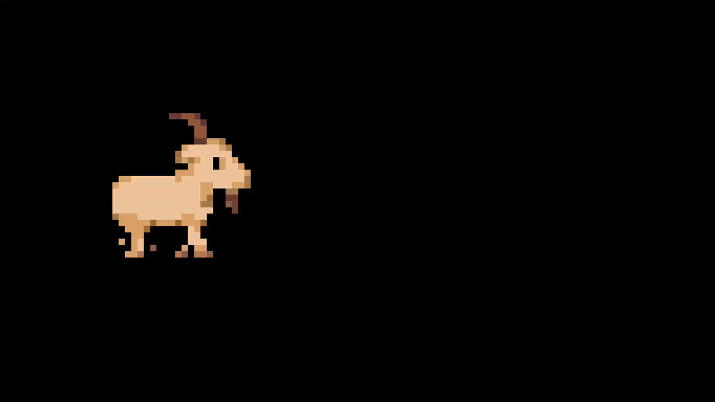

Slide 2

iGOAT
One goat saw it coming

Slide 3


Scientists: Jonas, Marvin, Max, Nicolas

Slide 4

Website
igoat.mendes.dev

Slide 5
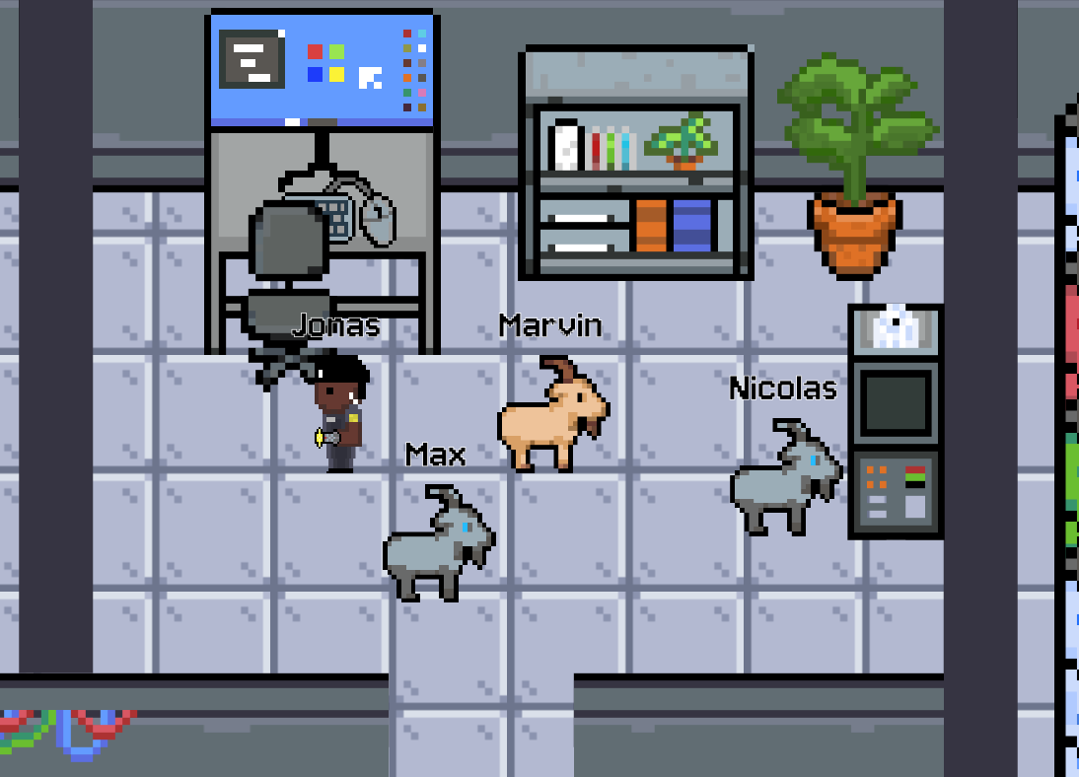
DEMO

Slide 6
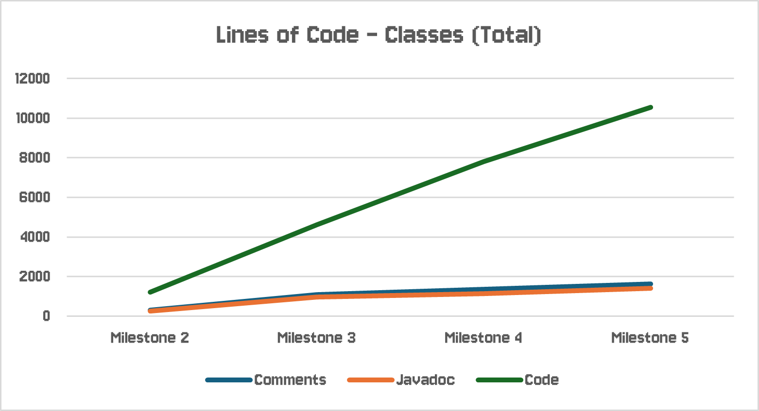
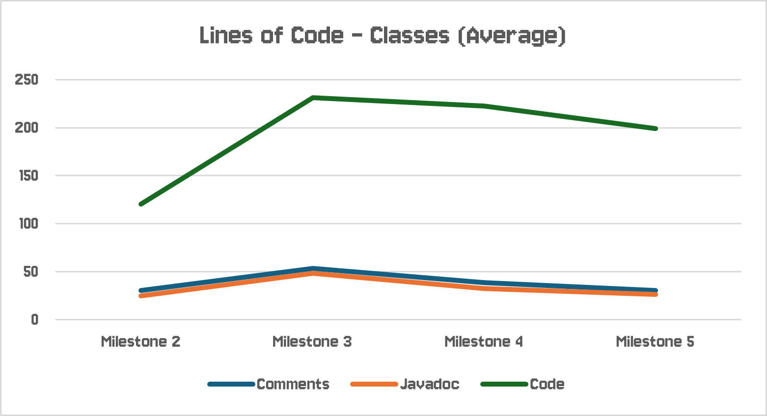
Quality Assurance: Lines of Code (Classes)

Slide 7
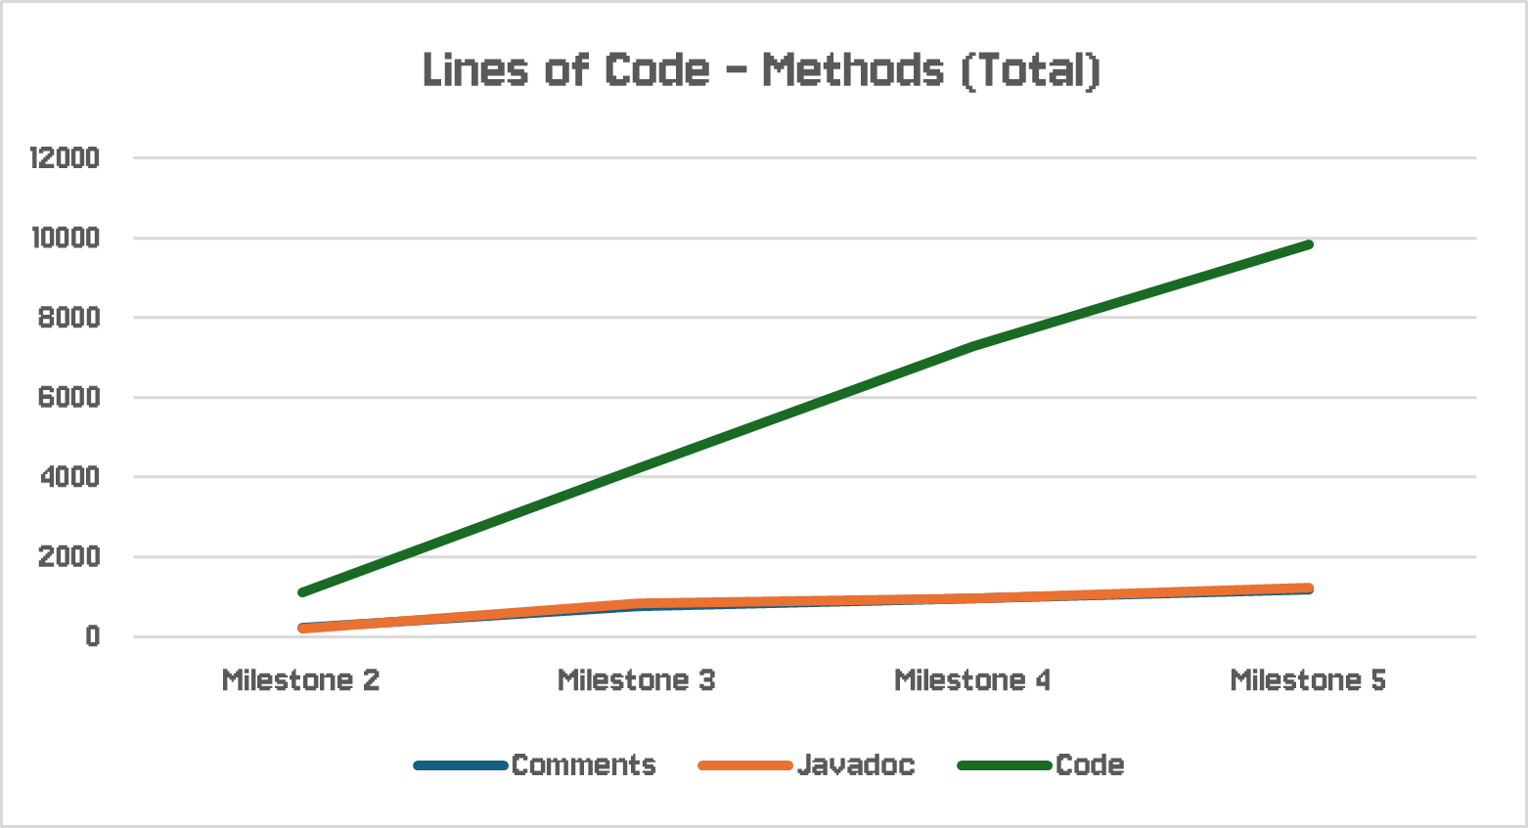
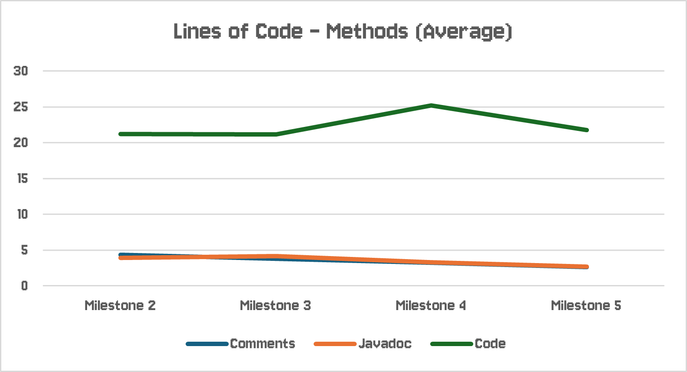
Quality Assurance: Lines of Code (Methods)

Slide 8
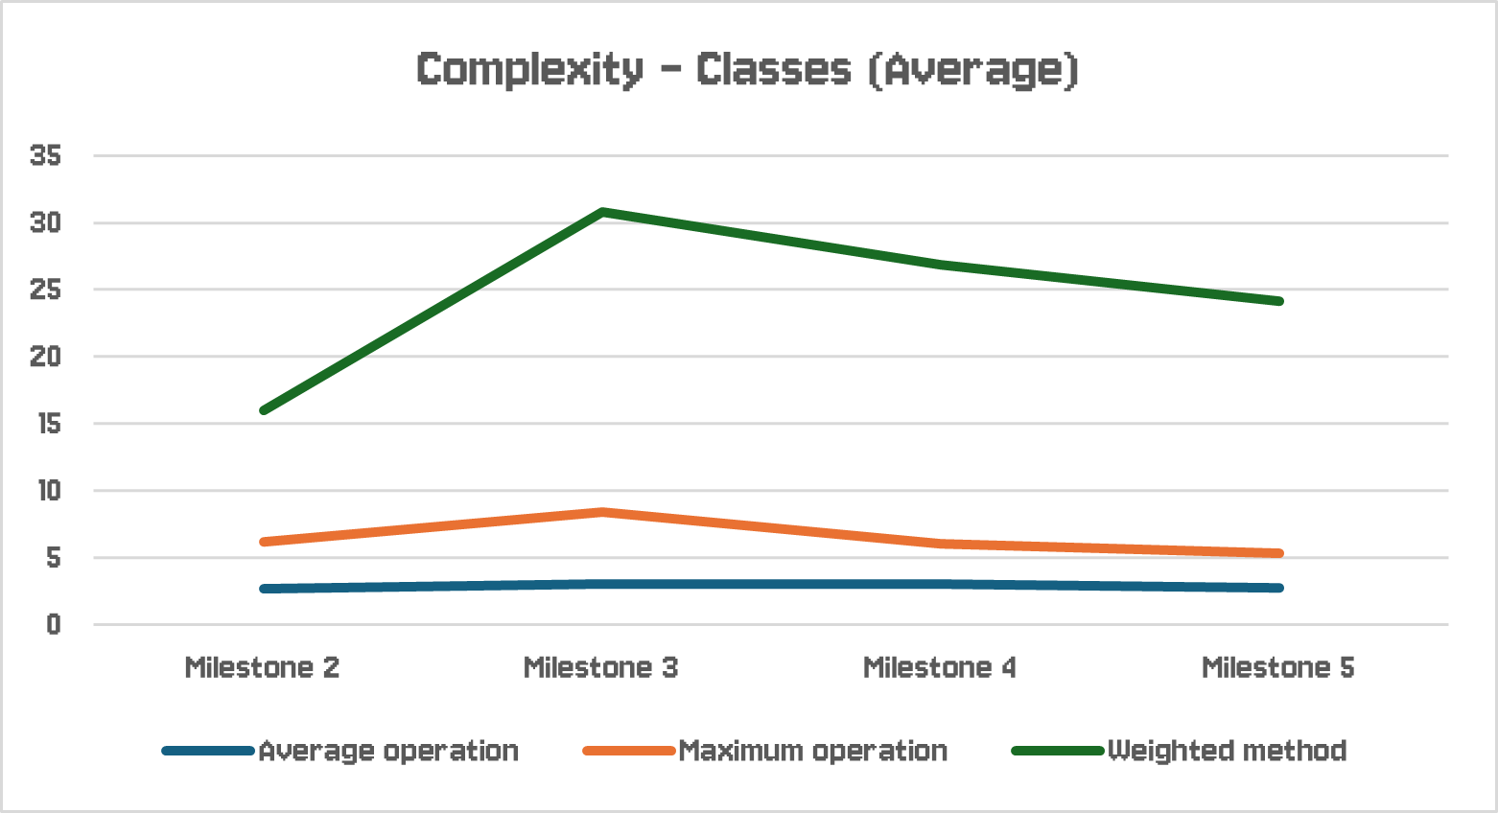
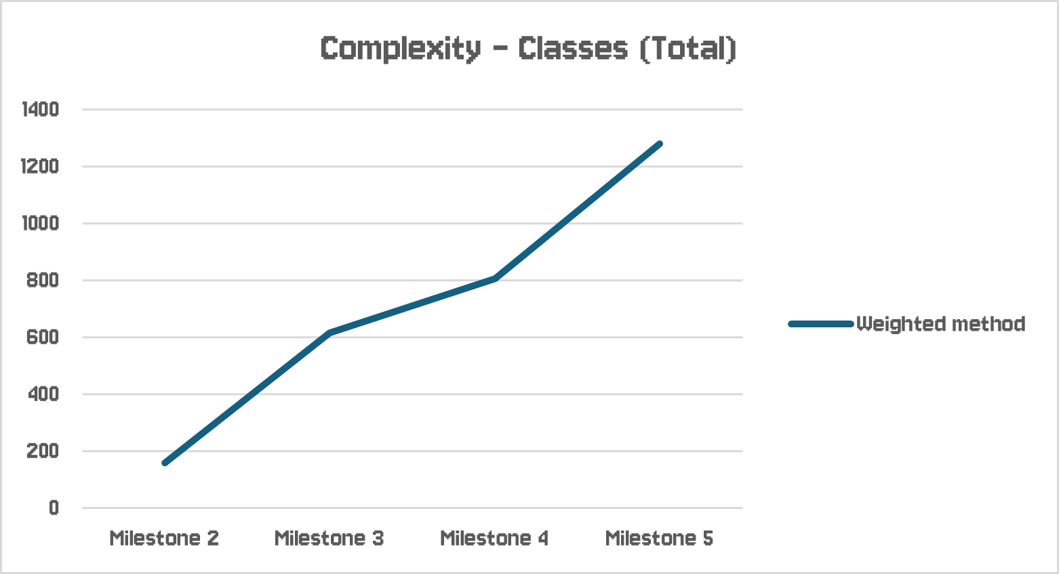
Quality Assurance: Complexity (Classes)

Slide 9
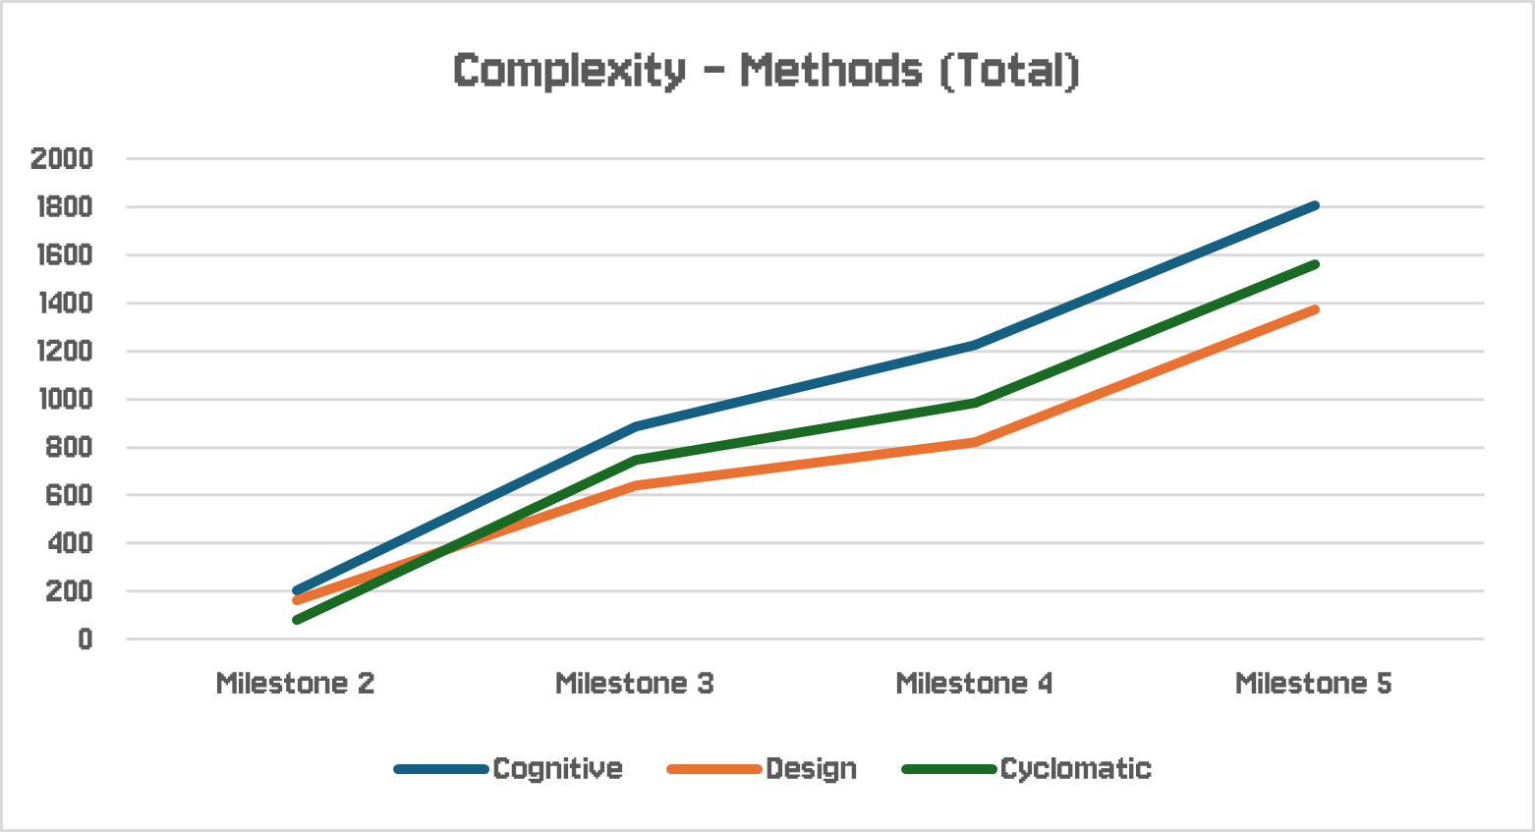
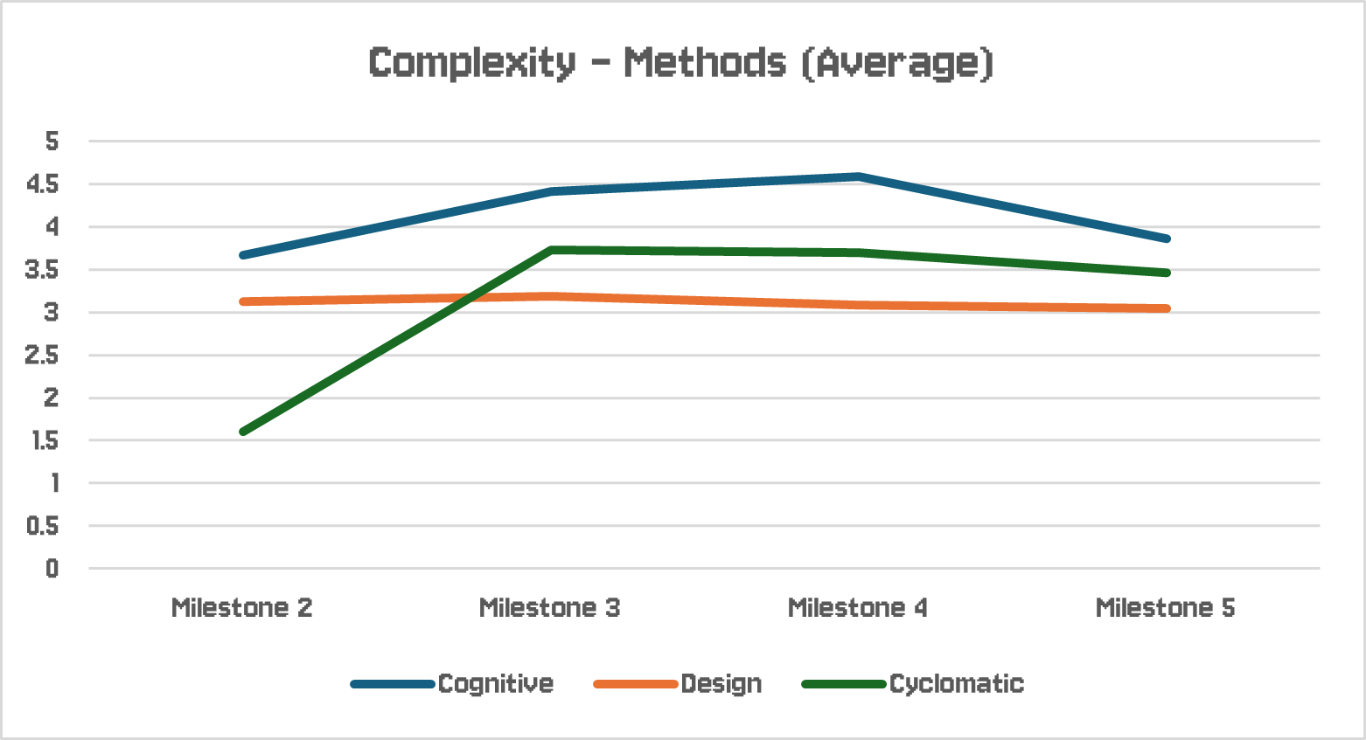
Quality Assurance: Complexity (Methods)

Slide 10
Technology
slf4j (Logging)
AnimateFX (Animations)

Slide 11
Lessons Learned
Code structure
git usage
Bug testing
Communication
Time management
Team work

Slide 12




Questions?
sponsored by

